Slide 1

Global warming

Slide 2
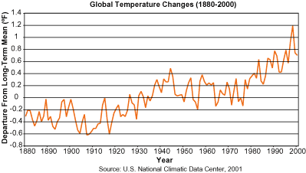
What is Global Warming?
An increase in the average temperature of the Earth’s atmosphere and oceans
Global temperature on both land and sea increased by 0.6 ± 0.2 °C over the past century
Volume of atmospheric carbon dioxide increased from 280 parts per million in 1800 to 367 in 2000, a 31% increase over 200 years

Slide 3
Our Changing Climate
Global mean surface temperatures have increased 0.5-1.0°F
since the late 19th century
The snow cover in the Northern Hemisphere and floating ice in the Arctic Ocean have decreased
Sea level has risen 4-8 inches over the past century
Global surface temp. could rise 1-4.5°F (0.6-2.5°C) in the next fifty years, and 2.2-10°F (1.4-5.8°C) in the next century

Slide 4
What causes it?
Human Impacts-
Atmospheric greenhouse gases trap some of the outgoing energy, retaining heat
Natural Impacts-
Change in sun’s energy output Volcanoes Water Vapor Clouds
Since industrial revolution, atmospheric concentrations of carbon dioxide increased 30%, methane more than doubled, nitrous oxide risen by 15%. These increases have enhanced the heat-trapping capability of the earth’s atmosphere

Slide 5
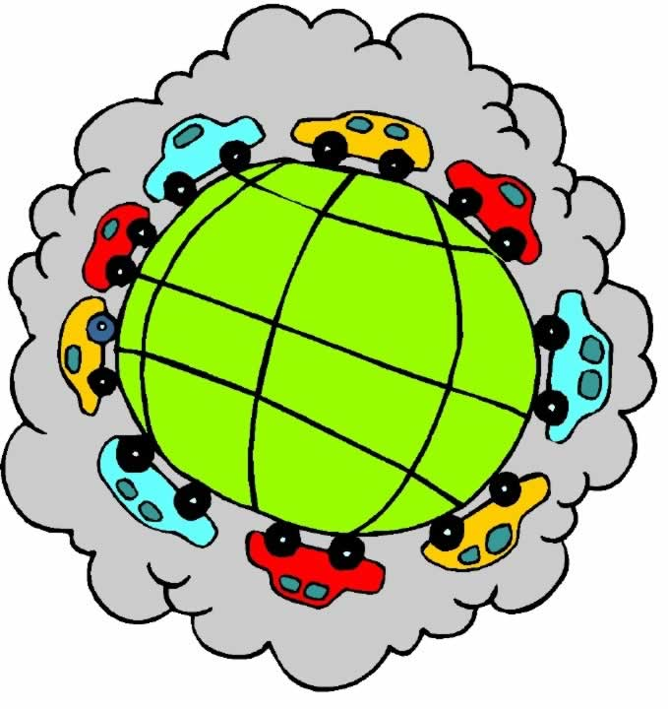
Greenhouse Gas Emissions
Combustion of fossil fuels→ coal-burning power plants, automobile exhausts, factory smokestacks, other waste vents of the human environment contribute 22 billion tons of carbon dioxide and other greenhouse gases each year
Animal agriculture, manure, natural gas, rice paddies, landfills, coal, and other anthropogenic sources contribute about 450 million tons of methane each year
Atmospheric concentrations of CO₂ and CH₄ have increased by 31% and 149% respectively above pre-industrial levels since 1750

Slide 6
Greenhouse Gas Emissions
Power Plants
40% of carbon dioxide emissions stem from the burning of fossil fuels for the purpose of electricity generation
Cars
20% of carbon dioxide emissions comes from the burning of gasoline in internal-combustion engines of cars and light trucks with poor gas mileage contribute the most to global warming
Trucks
Another 13% of carbon dioxide emissions come from trucks used mostly for commercial purposes

Slide 7
Greenhouse Gas Emissions
Airplanes
Aviation causes 3.5 percent of global warming, and the figure could rise to 15 percent by 2050
Carbon Dioxide from Buildings
Buildings structure account for about 12% of carbon dioxide emissions

Slide 8
Greenhouse Gases
Methane
Methane is more than 20 times as effective as CO2 at trapping heat in the atmosphere.
2004 Levels of atmospheric methane have risen 145% in the last 100 years.
Derived from sources such as rice paddies, bovine flatulence, bacteria in bogs and fossil fuel production.
In flooded fields, anaerobic conditions develop and the organic matter in the soil decomposes.

Slide 9
Greenhouse Gases
Nitrous oxide
Naturally produced by oceans and rainforests
Man-made sources - nylon and nitric acid production, the use of fertilizers in agriculture, cars with catalytic converters and the burning of organic matter

Slide 10
Greenhouse Gases main cause
Deforestation
Responsible for 25% of all carbon emissions entering the atmosphere by the burning and cutting of about 34 million acres of trees each year

Slide 11
Effects of Global Warming
Negative Effects
Rising Sea Level
Change of precipitation and local climate conditions; acid rain
Alteration of forests and crop yields
Expansions of deserts into existing rangelands
More intense rainstorms
Destabilization of Ocean currents
Positive Effects
Can stimulate plant growth in places where CO2 and temperature are the limiting factors (preventing photorespiration which can destroy existing sugars)
Melting Arctic ice may open the Northwest Passage in summer, which would cut 5,000 nautical miles from shipping routes between Europe and Asia

Slide 12
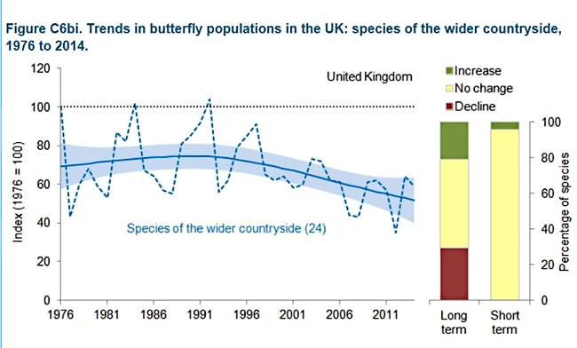
Population of butterflies in united kingdom

Slide 13
Population of butterflies in united kingdom
Warming temperatures have been shown to have both positive and negative effects on populations of British butterflies. Species at the northern limit of their ranges have been able to expand their ranges, moving northwards throughout the UK.
Species such as Orange-tip and Peacock have become common in Scotland as the climate has become suitable.
Silver-spotted Skipper has been able to colonise new habitats on north facing slopes, having previously been mainly restricted to south facing slopes.

Slide 14
Population of butterflies in united kingdom
Migrant species have also increased in number in response to recent warming.
Red Admiral, in particular, and Clouded Yellow to a lesser extent, now regularly over-winter in the UK to produce resident populations due to increasingly favourable conditions.
Recent rapid range expansion in the Brown Argus is associated with increased use of geranium species as host plants brought about by climatic suitability with recent warming

Slide 15
Population of butterflies in united kingdom
Community composition changes are rapid but different between birds and butterflies. Both groups do not keep up with temperature increases and suggest a climatic debt at national and continental scales.

Slide 16
Population of butterflies in united kingdom(habitat related)
Landscape structure affects the recovery of butterfly populations after extreme events. The Ringlet butterfly shows population crashes after severe droughts. These crashes are reduced, and the recovery thereafter increased, in larger and more connected patches of woodland habitat.
In warmer years butterflies use a greater range of habitats, yet habitat breadth has decreased over time for most species. Habitat degradation continues to be a major driver of reductions in habitat breadth and population density of butterflies.

Slide 17
Population of butterflies in united kingdom (habitat related)
Butterfly dispersal is related to habitat quality between sites. Populations separated by more suitable habitat tend to show increased similarity in the yearly fluctuations in butterfly population counts.
Butterfly populations benefit from having a mixture of habitats available. Populations of butterflies are more stable, and thus more likely to persist, in heterogeneous landscapes

Slide 18
Population of butterflies in united kingdom (how it affects ecosystem)
The monarch butterfly is considered the most recognized backyard butterfly in North America, and it is known for its annual migrations of more than 3,219 km (2,000 mi) over several generations. Most of the monarchs of North America east of the Rocky Mountains migrate south to overwinter in a small pine forest area in Mexico known as the Monarch Butterfly Biosphere Reserve. The closely monitored numbers found at that site provide an indication of the health of the North American monarch butterfly population. The winter of 2012–13 showed a worrisome 59% decrease in monarch populations from the previous year; it was the lowest count recorded in at least two decades.
For years monarch butterfly conservation efforts were concentrated on preserving the overwintering site in Mexico, but the focus has gradually turned northward. The loss of milkweed habitat—milkweed being the primary host plant upon which monarch caterpillars feed—has been attributed to an increase in the use of Roundup in agriculture. The herbicide can be liberally applied to genetically modified (GM) crops without risk to them, but species such as milkweed (normally found in fields) have been suffering, and monarchs might be paying the price for the decimation of the plants.

Slide 19
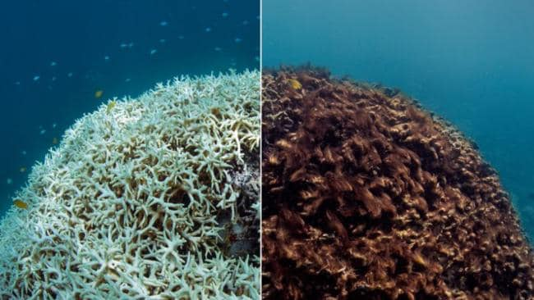
Damage to coral reefs

Slide 20
Damage to coral reefs (major cause)
As temperatures rise, mass coral bleaching events and infectious disease outbreaks are becoming more frequent. Additionally, carbon dioxide absorbed into the ocean from the atmosphere has already begun to reduce calcification rates in reef-building and reef-associated organisms by altering seawater chemistry through decreases in pH. This process is called ocean acidification.

Slide 21
Damage to coral reefs (all other factors)
A warming ocean: causes thermal stress that contributes to coral bleaching and infectious disease.
Sea level rise: may lead to increases in sedimentation for reefs located near land-based sources of sediment. Sedimentation runoff can lead to the smothering of coral.
Changes in storm patterns: leads to stronger and more frequent storms that can cause the destruction of coral reefs.
Changes in precipitation: increased runoff of freshwater, sediment, and land-based pollutants contribute to algal blooms and cause murky water conditions that reduce light.

Slide 22
Damage to coral reefs (all other factors)
Altered ocean currents: leads to changes in connectivity and temperature regimes that contribute to lack of food for corals and hampers dispersal of coral larvae.
Ocean acidification (a result of increased CO₂): causes a reduction in pH levels which decreases coral growth and structural integrity

Slide 23
Damage to coral reefs (how to control)
Shrink your carbon footprint to reduce greenhouse gases.
Reduce, reuse, or recycle.
Reduce the use of lawn and garden chemicals.
DO NOT dump household chemicals in storm drains.

Slide 24
KYOTO Protocol
The Kyoto Protocol is an international treaty which extends the 1992 United Nations Framework Convention on Climate Change (UNFCCC) that commits state parties to reduce greenhouse gas emissions, based on the scientific consensus that global warming is occurring and it is extremely likely that human made CO₂ emissions have predominantly caused it. The Kyoto Protocol was adopted in Kyoto, Japan on 11th December 1997 and entered into force on 16th February 2005. There are currently 192 parties (Canada withdrew from the protocol, effective December 2012) to the Protocol.

Slide 25
Targets for Kyoto protocol
Carbon dioxide (CO2)
Methane (CH4)
Nitrous oxide (N2O)
Hydrofluorocarbons (HFCs)
Perfluorocarbons (PFCs)
Sulphur hexafluoride (SF6)

Slide 26
Thanks...!

